Slide 1
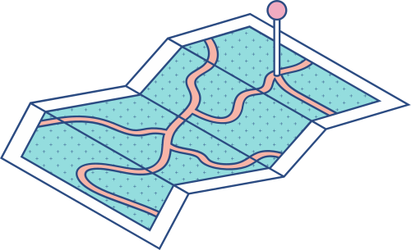





Global Connectivity Framework & 5G IoT Resource Sharing
Abhishek Yadav (1RV21CS009)
Hardik Hiraman Pawar (1RV21CS046)
Harshit Dhoot (1RV21CS049)
Karan Sathish (1RV21CS058)

Slide 2
Index
1
2
3
4
5
UNDERSTANDING THE DATASET
CALCULATING AND VISUALIZING LATENCY DATA
CALCULATING AND VISUALIZING LOAD DATA
MULTI BAR CHART FOR COMBINED ANALYSIS OF LATENCY AND LOAD
APPLICATIONS AND CONCLUSION

Slide 3
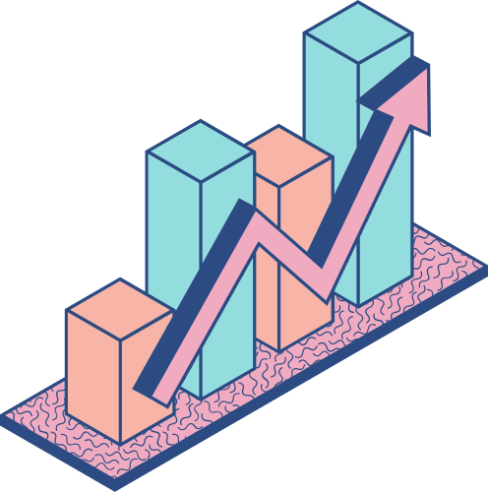
Understanding the Dataset

Slide 4

Dataset Source
THE DATASET USED IN THIS PROJECT PLAYS A FUNDAMENTAL ROLE IN SHAPING OUR GLOBAL CONNECTIVITY FRAMEWORK AND 5G IOT RESOURCE SHARING ANALYSIS. IT IS DERIVED FROM http://www.topology-zoo.org, a reputable source for network topologies. This dataset contains crucial information about various network nodes, enabling us to define and analyze network structures in different regions.

Slide 5
BT Asia Pacific Region
This region encompasses nodes from diverse Asian and Oceanic countries, including Indonesia, Australia, Singapore, Malaysia, and more. It provides detailed information about each node's country, longitude, and latitude, forming the foundation for our analysis.
Quest Region
The Quest region defines nodes based on data obtained from an external source. It includes nodes within the Quest network. Information such as country, longitude, and latitude is used to establish the nodes within this network.
Regions Considered

Slide 6
TATA Region
Similarly, the TATA region defines nodes based on data from an external source, representing the TATA network. The dataset specifies crucial details, including the country, longitude, and latitude of nodes within this network.
ERNET Region
Focused on India, the ERNET region incorporates nodes from cities like Pune, Indore, Trivandrum, Mumbai, and more. It provides comprehensive insights into each node's country, longitude, and latitude, aiding our analysis of this region.
Regions Considered

Slide 7
PERN Region
The PERN region features nodes in Pakistan, including cities like Peshawar, Karachi, Faisalabad, Quetta, Lahore, and others. Similar to other regions, it furnishes vital data about each node's country, longitude, and latitude.
Regions Considered

Slide 8
Calculating and Visualizing Latency Data

Slide 9
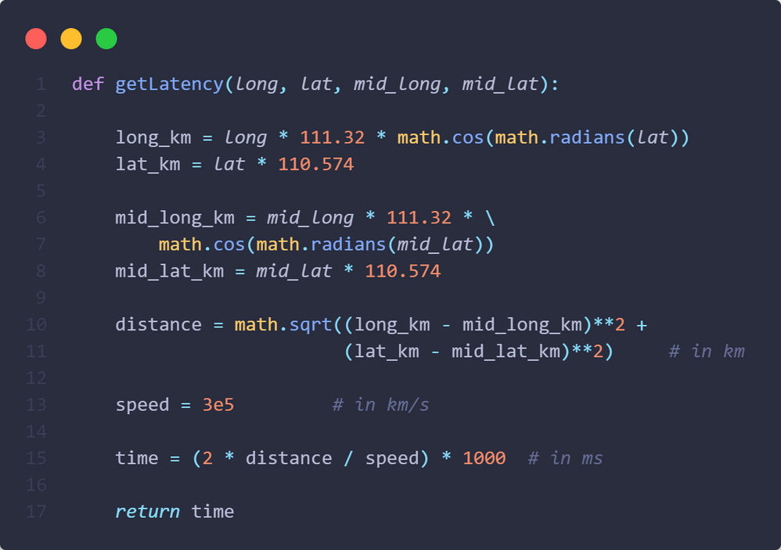
Latency Calculation
We compute the latency (delay) for each network node using the formula: Latency = 2 * distance / speed.
Latitude and longitude information is leveraged to determine the distance between nodes, while the speed of data transmission is set at 300,000 km/s.

Slide 10
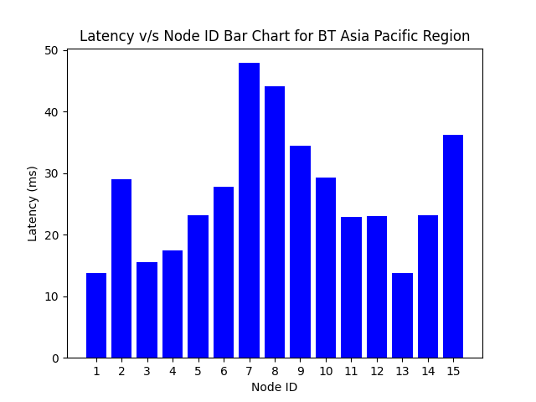
Graph Visualization
We visualize latency data through a series of informative graphs.
Initially, we plot the latency graph in its natural order, offering insights into the latency distribution among network nodes.

Slide 11
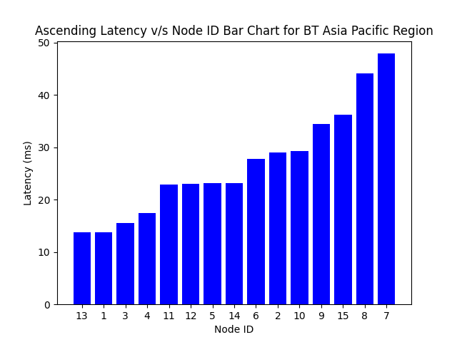
Ascending Latency Order
To facilitate a more detailed analysis, we rearrange the latency data in ascending order.
This enables us to identify nodes with the lowest and highest latencies, aiding in load distribution decisions.

Slide 12
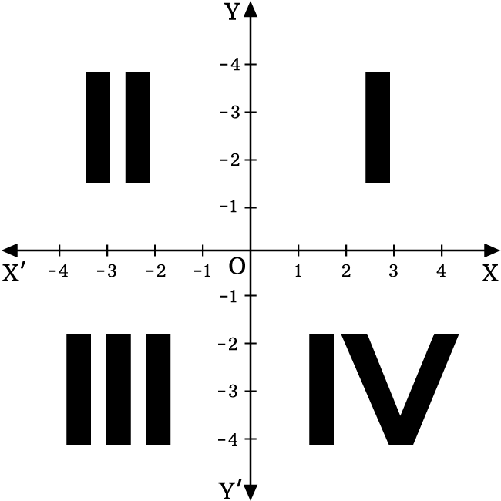
Clustering Nodes
The network nodes are grouped into four quadrants, assuming the midpoint as the origin.
This clustering approach allows us to understand the spatial distribution of nodes and their respective latencies within each quadrant.

Slide 13
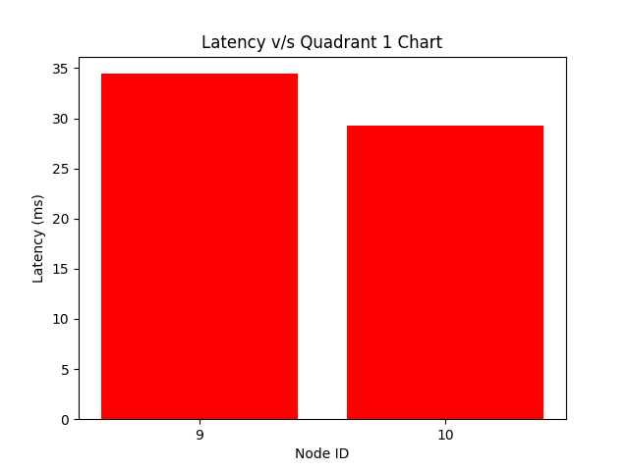
Quadrant 1

Slide 14
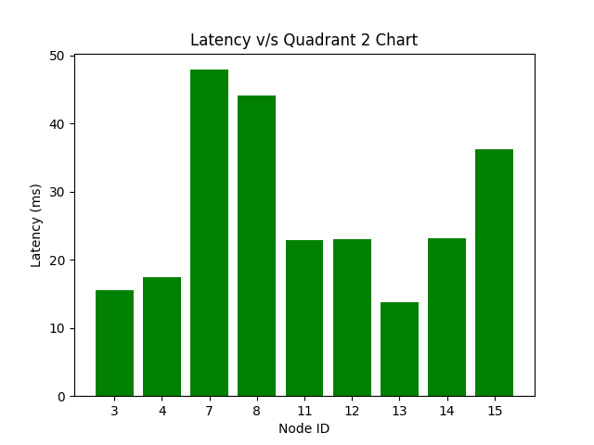
Quadrant 2

Slide 15
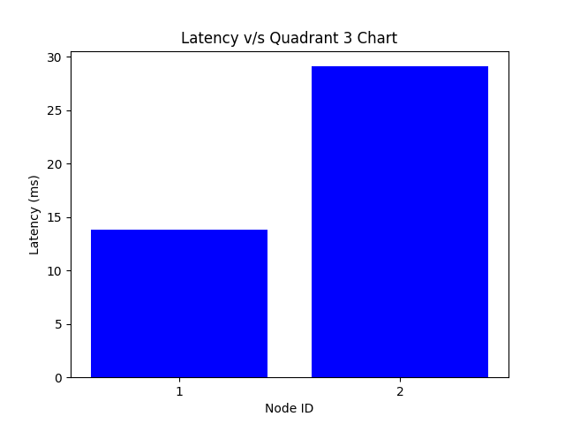
Quadrant 3

Slide 16
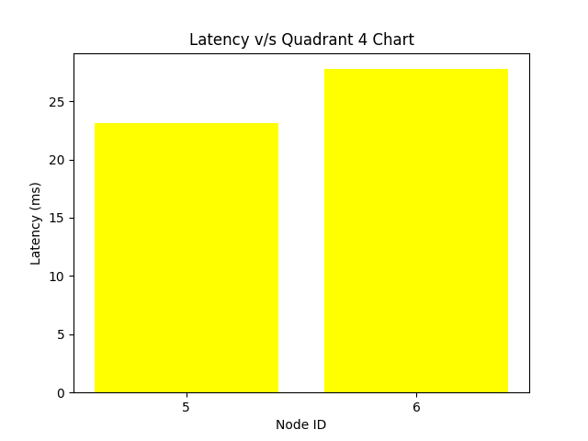
Quadrant 4

Slide 17
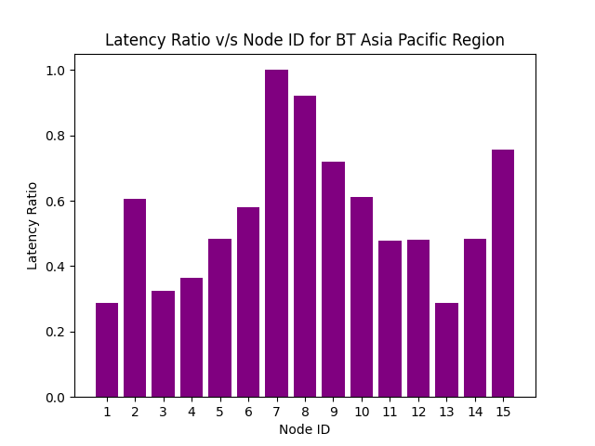
Latency Ratio Analysis
We normalize latency values to a range between 0 and 1 for further analysis.
The normalized latency ratios help identify nodes with the greatest impact on latency and potential resource sharing improvements.

Slide 18
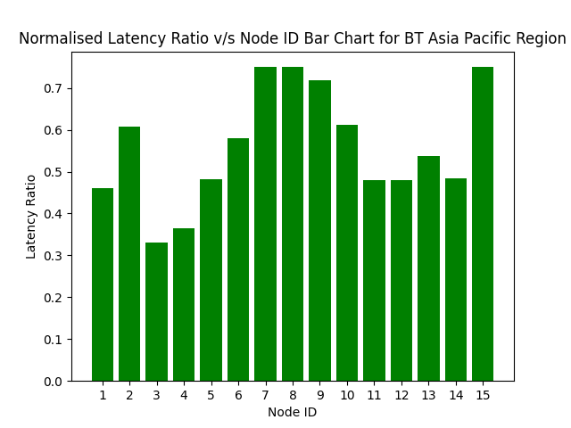
Load Balanced Latency Ratio
The nodes with latency greater than or equal to a certain threshold are identified and the load is balanced to the nodes with the least load.
This in turn, helps lessen congestion and improve throughput of the network system.

Slide 19
Calculating and Visualizing Load DATA

Slide 20
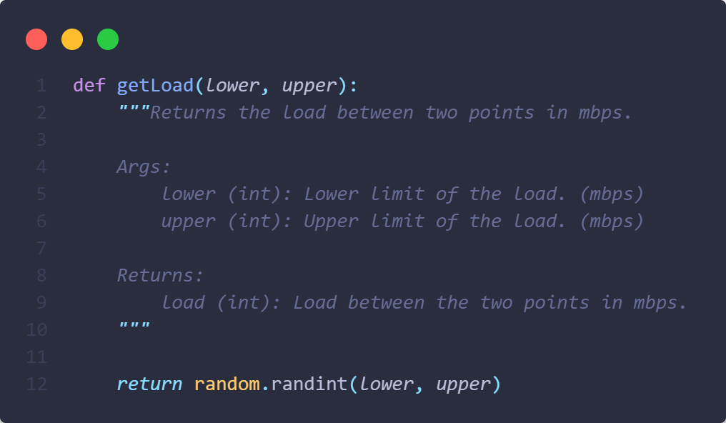
Load Generation
To simulate real-world network conditions, we randomly generate load values for each node within specified lower and upper limits. These load values represent the amount of data traffic that each node can handle, measured in megabits per second (Mbps).

Slide 21
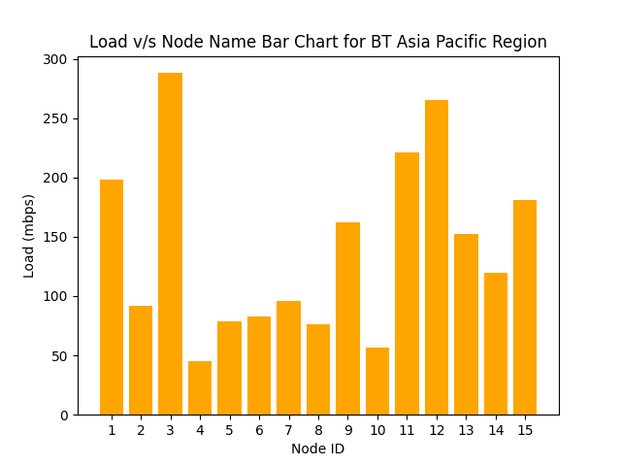
Load Ratio Visualization
We plot a bar chart that visualizes the load values for each node. This provides an overview of the distribution of load across the network, helping us identify nodes that may be underutilized or overloaded.

Slide 22
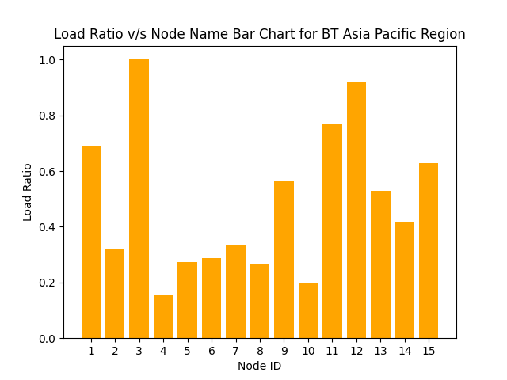
Load Ratio Normalization
To facilitate meaningful comparisons, we normalize the load values to a range between 0 and 1. This normalization ensures that even if the load values vary widely, they can be compared on a consistent scale.

Slide 23
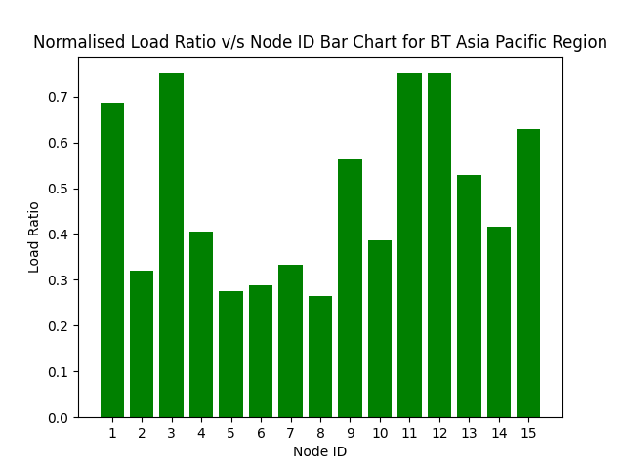
Load Balancing
Load balancing is a crucial aspect of network optimization. We aim to balance the load across nodes to prevent congestion and ensure efficient data transmission. Nodes with load ratios exceeding a defined threshold are considered for load redistribution.

Slide 24
Multi Bar Chart for Combined Analysis of Latency and Load

Slide 25
Combined Analysis
The multi-bar chart combines latency and load ratio data for each node. Latency is represented by one set of bars, while load ratios are represented by another set. This combination allows for a comprehensive assessment of network performance.
The chart is structured with nodes on the X-axis and latency and load ratio on the Y-axis. Latency and load ratios are visually represented for each node, making it easy to identify nodes with latency or load issues.
This multi-bar chart provides a holistic view of network performance, highlighting nodes that may require optimization or load balancing. It serves as a valuable tool for network administrators and engineers to make informed decisions about network management and improvements.

Slide 26
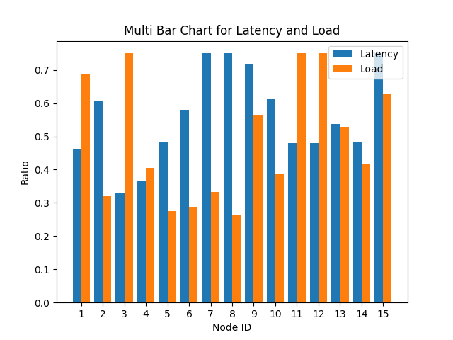
Multi Bar Chart Latency & Load Visualization

Slide 27
Applications and Conclusion

Slide 28
Network Optimization
The project can be applied to optimize computer networks, data centers, or cloud infrastructures. By analyzing latency and load data, network administrators can identify bottlenecks and make necessary adjustments to improve overall network performance.
Content Delivery Networks (CDNs)
CDNs can use this project to strategically place content servers based on network latency and load. This ensures faster content delivery to end-users and a more efficient use of resources.
Applications

Slide 29
Traffic Management
Traffic management systems can benefit from this project by optimizing routing decisions. By considering both latency and load, traffic can be directed through paths that minimize delays and prevent network congestion.
Gaming Networks
Online gaming networks require low-latency connections. This project can help gaming platforms allocate resources to players in a way that minimizes latency, enhancing the gaming experience.
Applications

Slide 30
Conclusion
IN CONCLUSION, THIS PROJECT OFFERS A COMPREHENSIVE SOLUTION FOR ANALYZING AND OPTIMIZING NETWORK PERFORMANCE BY CONSIDERING BOTH LATENCY AND LOAD. BY VISUALIZING THESE KEY METRICS IN A MULTI-BAR CHART, NETWORK ADMINISTRATORS GAIN VALUABLE INSIGHTS INTO THE HEALTH OF THEIR NETWORKS AND CAN MAKE DATA-DRIVEN DECISIONS FOR IMPROVEMENTS.

Slide 31
GitHub Repository Link

Slide 32

Thank You!

